Slide 1
Athletic Compliance Educational Session
Academy of Holy Angles
October 3, 2023

Slide 2
Athletic Compliance Educational Session
NCAA Initial Eligibility and Recruiting
John Wallace
Associate Director of Athletic Compliance
University of Minnesota
wallacej@umn.edu

Slide 3
Athletic Compliance Educational Session
Guide to the College Bound
Student-Athlete
Covers Recruiting and Eligibility
Download at www.ncaa.org (pdf.)
High school academic information (Divisions I, II, III)
NCAA Eligibility Center registration (Divisions I & II)
Google “NCAA Eligibility Center”
Sample questions to ask in the recruiting process

Slide 4
Athletic Compliance Educational Session
NCAA Eligibility Center
Located in Indianapolis, IN and run by the NCAA
Review high school transcripts and test scores for all Division I and II prospects
Register during your junior year in HS
Costs $90 to register ($150 for internationals)
SAT/ACT scores must be sent directly to the Eligibility Center by marking code 9999
Work closely with your HS counselor to determine core courses

Slide 5
Athletic Compliance Educational Session
NCAA Core Course
One full year of academic credit, taught at grade appropriate level.
The NCAA approves core courses, NOT the high school
Each high school has an approved core course list on the Eligibility Center’s website.
If the course is not on your high school list at the NCAA, it will not count as a core course
If a course title on your transcript does not match the title on the NCAA’s list, it will not count as a core course
Meet with high school academic counselor to review your enrollment and your planned courses

Slide 6
Athletic Compliance Educational Session
Determining Initial Eligibility
Academic Component:
Graduation;
Complete the minimum number of core courses;
Minimum core grade point average
Amateurism Component:
Complete amateurism questionnaire

Slide 7
Athletic Compliance Educational Session
Division I Core-Course Requirements – 16 core courses needed:
4 years of English
3 years of Math (Algebra I or Higher)
2 years of Natural/Physical Science (one lab)
1 year of additional English, Math or Science
2 years of Social Science
4 years of Additional Core courses
*** Need to plan for this – not just graduate!

Slide 8
Athletic Compliance Educational Session
10 Core courses must be completed prior to start of senior year in HS; 7 of 10 must be in the following areas:
English
Math (Algebra I or Higher)
Natural/physical science (one lab)
** The 10 core courses utilized to meet this rule may not be replaced by a course taken in the senior year.
Early Qualifier – 3.0 core with 14 done (3 Eng., 2 math, 2 science, 2 additional EMS, 5 additional) after 6 semesters

Slide 9
Athletic Compliance Educational Session
Division II –16 core courses needed:
3 years of English
2 years of Math (Algebra I or Higher)
2 years of Natural/Physical Science (one lab)
3 year of additional English, Math or Science
2 years of Social Science
4 years of additional core courses
Core grade-point average must be at least 2.200
Early Qualifier – 2.5 core with 14 done (3 Eng., 3 math, 2 science, 4 additional) after 6 semesters

Slide 10
Athletic Compliance Educational Session
Qualifier, Academic Redshirt, Non-qualifier
Qualifier
Athletic scholarship, practice and competition in your first year in residence
Four years to compete
Academic Redshirt
Athletic scholarship and practice only in your first year in residence
Four years to compete
Non-Qualifier
No scholarship, practice or competition in your first year in residence
Only three years to compete, with ability to regain 4th

Slide 11
Athletic Compliance Educational Session
COVID-19 Waiver for Fall 2023/Spring 2024 Enrollees
Alternative Standard | Division I | Division II
Qualifier: athletics aid, practice, & competition | 10/7 before 7th semester, 16 core courses in required subject areas, >2.30 core gpa, proof of graduation, no test score | 16 core courses in required subject areas, > 2.20 core gpa, proof of graduation, no test score
Early Qualifier: athletics aid, practice, & competition | Pre-7th semester: 14 core courses in required subject areas, > 3.00 core gpa, no test score | Pre-7th semester: 14 core courses in required subject areas, > 2.50 core gpa, no test score
Academic Redshirt: athletics aid (1st year) and practice (1st term) | 16 core credits in the required subject areas, > 2.00 core gpa, proof of graduation, no test score | N/A
Partial Qualifier: athletics aid and practice | N/A | 16 core credits in the required subject areas, > 2.00 core cpa, proof of graduation

Slide 12
Athletic Compliance Educational Session
COVID-19 Waiver for Fall 2023/Spring 2024 Enrollees
Distance learning, hybrid learning, and e-learning options will not require a separate evaluation by the Eligibility Center
Pass/Fail courses: if issued a grade of Pass, the EC will apply the credit earned. If If the core gpa would increase by assigning a 2.30 to the course, the gpa will be assigned, but if it will hurt the core gpa, the gpa will not be assigned, but the credit will still be issued.
Both of these policies will apply to other classes (e.g. sophomores, juniors, and seniors).

Slide 13
Athletic Compliance Educational Session
College Admission Process vs. NCAA Eligibility
Two separate determinations
Being a NCAA qualifier does not automatically mean you will be admitted to an institution
Being admitted to an institution does not mean you are eligible under NCAA requirements

Slide 14
Athletic Compliance Educational Session
Amateurism – Final Step
Prospects jeopardize NCAA amateur status by:
Formally declaring into professional contract, compete with a professional team in hockey or skiing, or accept a salary
Accepting prize money that exceeds expenses for an athletic event
Entering into agreement or accepting benefits from agents

Slide 15
Athletic Compliance Educational Session
General Recruiting Concepts
Rules are designed to protect the HS students
ASK QUESTIONS!!

Slide 16
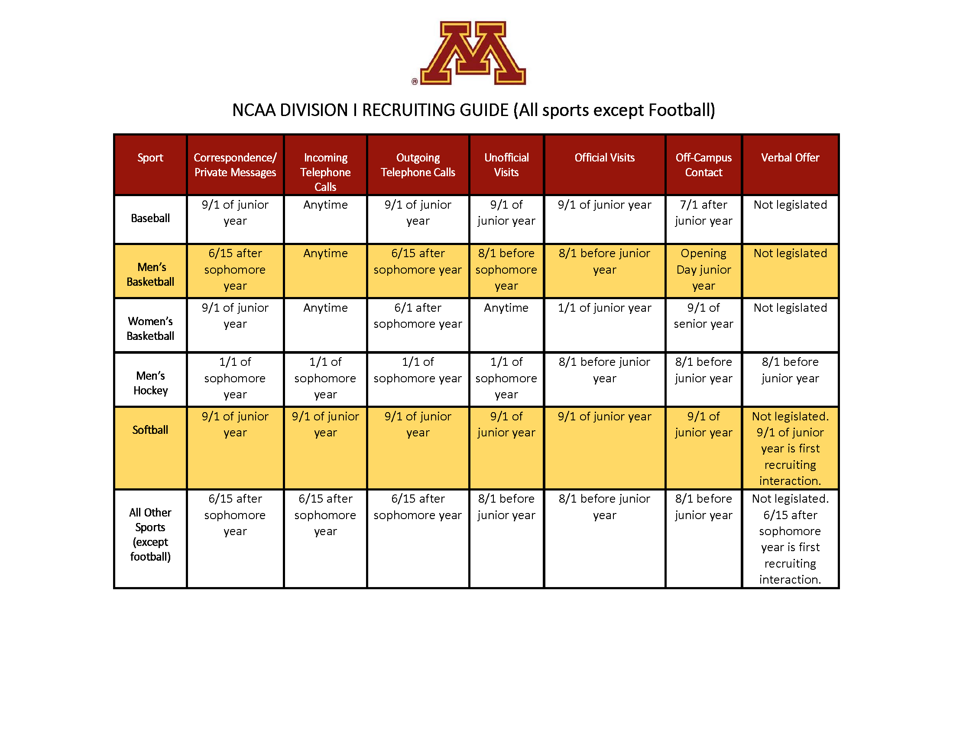
Athletic Compliance Educational Session
General Recruiting Concepts

Slide 17
Athletic Compliance Educational Session
Financial Aid / Scholarship Basics
DIII schools do not offer athletic scholarships
Other financial aid packages may be available
NLI is a contract between athlete and college (DI & DII)
Scholarship offer must accompany the NLI
Athletic scholarships may be multi-year agreements between prospect and institution. This is at the offering institution’s discretion.
Full Scholarship = tuition & required fees, room & board, books, and cost of attendance
Summer aid: potentially available for scholarship athletes
Fifth-year (exhausted eligibility) athletic aid to graduate may be available

Slide 18
Athletic Compliance Educational Session
Division I Financial Aid / Scholarships
Some sports are “full-ride” scholarships (Head Count Sport)
Football (85)
M Basketball (13)
W Basketball (15)
W Gymnastics (12)
W Volleyball (12)
W Tennis (8)

Slide 19
Athletic Compliance Educational Session
Division I Financial Aid / Scholarships
Some sports are able to divide scholarships (Equivalency Sports)
Hockey (18)
M Track/CC (12.6)
W Track/CC (18)
M Lacrosse (12.6)
W Lacrosse (12)
Wrestling (9.9)
Softball (12)
Baseball (11.7)
M Golf (4.5)
W. Golf (6)
M Tennis (4.5)
M Soccer (9.9)
W Soccer (14)
Rowing (20)
M Swimming/Diving (9.9)
W Swimming/Diving (14)

Slide 20
Athletic Compliance Educational Session
Questions??
John Wallace
Associate Director of Athletic Compliance
University of Minnesota
wallacej@umn.edu
Follow us on Twitter!
@GopherGuardian

